Slide 1



Transborder Freight Analysis

Slide 2


Project Overview
Goal: Analyze US transborder freight data from 2020 to 2024 to uncover key patterns and insights.
Framework Used: CRISP-DM
Tools: Google Colab, Python, Pandas, Seaborn, GitHub
Data Source: US Bureau of Transportation Statistics

Slide 3


CRISP-DM Overview
Business Understanding
Data Understanding
Data Preparation
Modeling (EDA)
Evaluation
Deployment

Slide 4



Business Questions
What are the top modes of transportation used for transborder trade by total value and shipping weight?
Which partner countries (e.g., Canada or Mexico) contribute most to trade in terms of value and volume?
How does the trade value and shipping weight vary across different months and years?
What’s the difference in total value, shipping weight, and freight charges between domestic and foreign produced merchandise?
Which mode of transportation incurs the highest average freight charges?
Are there notable trends in freight movement across different U.S. border states over time?
What are the most common trade types (import/export), and how do their values and weights compare over time?

Slide 5


18+ zipped datasets
Covers Jan 2020 – mid 2024
Key fields:
VALUE,
SHIPWT,
FREIGHT_CHARGES,
COUNTRY,
DISAGMOT,
TRDTYPE,
YEAR,
MONTH
Data Overview
Cleaned, concatenated, and preprocessed in Google Colab

Slide 6

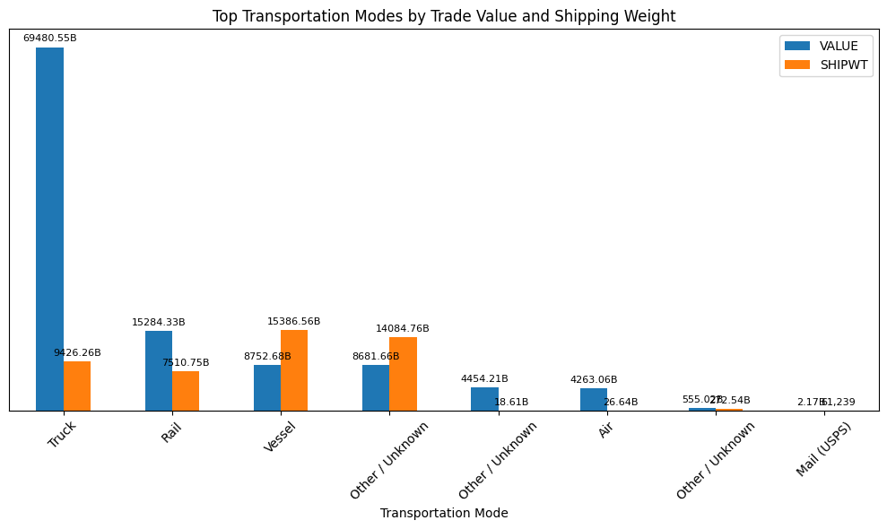
Top modes of transportation used (by total value & shipping weight)
The analysis reveals that Truck is the dominant mode of transportation for transborder trade, accounting for the highest trade value ($69.5B) and shipping weight (9.4B kg). This highlights its vital role in cross-border logistics, especially between the U.S., Canada, and Mexico.
Rail, with significant contributions in both value and weight.
Vessel, which shows a higher shipping weight (15.4B kg) than trade value.
Air and Mail (USPS) contribute the least, indicating their limited use for large-scale freight.

Slide 7
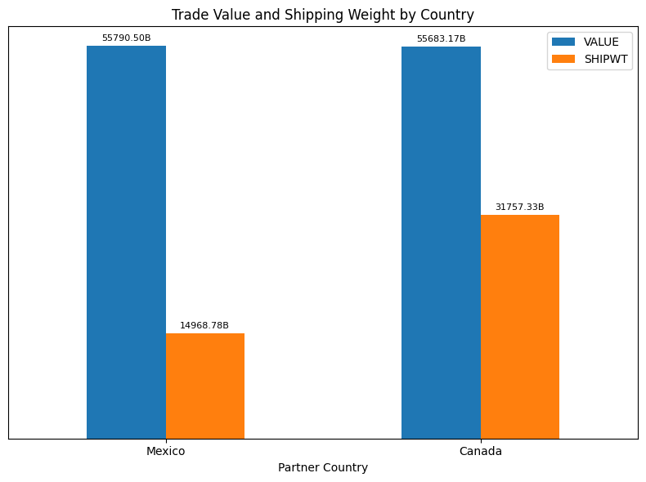

The analysis reveals that Mexico slightly surpasses Canada in total trade value, with $55.8B compared to Canada's $55.7B, highlighting both as equally critical trade partners.
However, Mexico leads overwhelmingly in shipping weight, contributing 1,496.9B kg, while Canada accounts for only 31.8B kg.
Mexico handles larger volumes of goods, potentially lower in individual value.
Canada, while nearly equal in trade value, involves smaller volumes, possibly higher-value items.
The stark contrast in shipping weight highlights differing trade dynamics with each country.
Partner countries which contribute most to trade (in value and volume).

Slide 8


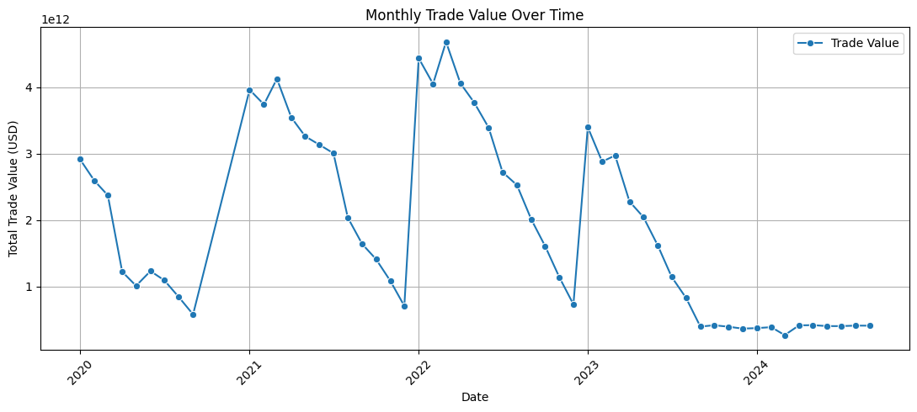
How does the trade value and shipping weight vary across different months and years?
The analysis reveals a steady growth in monthly trade value from 2020 to 2024, with notable surges in 2021 and 2022, likely due to post-pandemic recovery efforts.
Seasonal spikes, particularly at the end of the year, indicating increased trade activity around holidays.
Noticeable dips in early-year and mid-year months (e.g., January and July).
A flattening trend in 2024 suggests potential market stabilization or economic challenges like inflation.

Slide 9
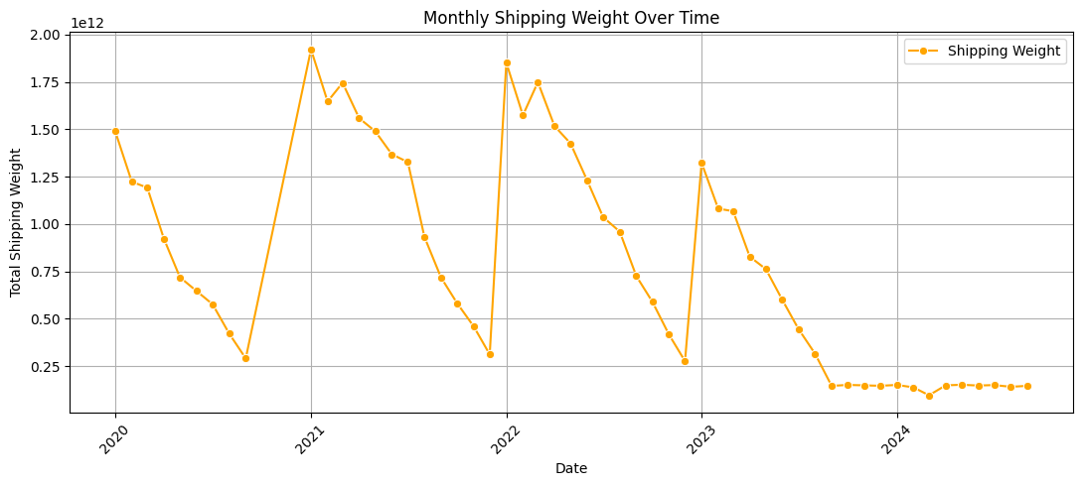
How does the trade value and shipping weight vary across different months and years?
The analysis reveals a dramatic increase in shipping weight from approximately 250 billion kg in 2020 to nearly 1.75 trillion kg by 2024, representing a 7x growth in volume.
Key observations include:
Accelerated growth during 2021–2022, likely fueled by post-pandemic recovery and surging demand.
Seasonal peaks in December align with trade value trends, confirming predictable shipping cycles.
2023–2024 shows signs of stabilization, possibly due to logistics capacity constraints or market saturation.
The faster growth in weight compared to value suggests a shift toward bulk, lower-value goods, such as raw materials or intermediate inputs.

Slide 10

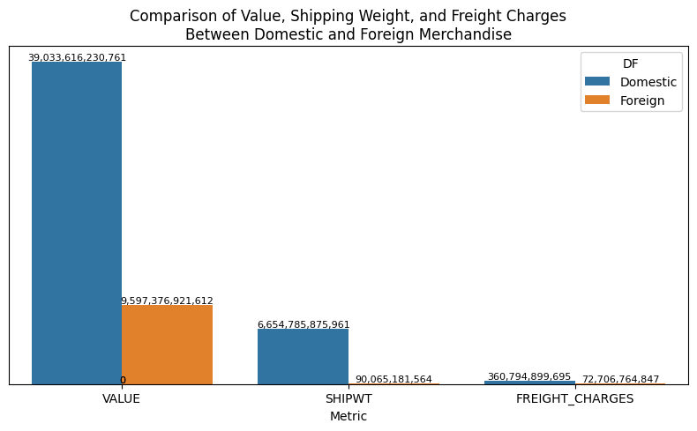
Difference in total value, shipping weight, and freight charges between domestic and foreign produced merchandise.
Trade Value (USD):
Domestic: $39.03 trillion
Foreign: $9.60 trillion
The analysis shows that domestic trade accounts for 4x the value of foreign trade, confirming its central role in the trade ecosystem.
Shipping Weight (kg):
Domestic: 90.07 billion
Foreign: 360.79 billion
The analysis shows that foreign shipments are 4x heavier, indicating a prevalence of bulk goods such as raw materials or industrial components.
Freight Charges (USD):
Domestic: $6.65 trillion
Foreign: $72.71 billion
The analysis shows that domestic freight costs are 91x higher than foreign charges, despite the lighter weight which shows a significant disparity.
The extreme disparity in freight charges (domestic vs. foreign) warrants investigation; are there hidden fees, inefficiencies, or data reporting gaps?

Slide 11
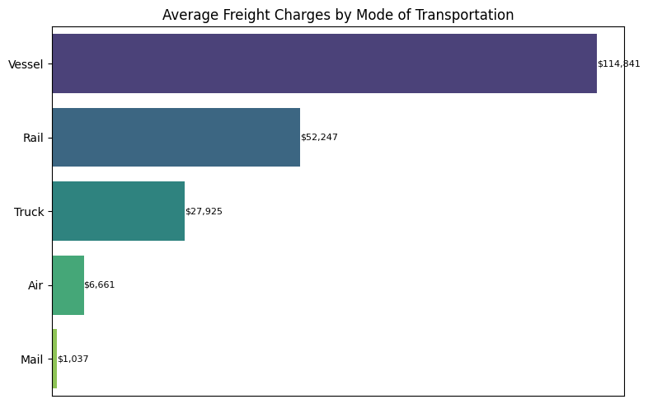
Transportation modes which incurs the highest average freight charges?
The analysis reveals that Vessel is the most expensive transportation mode on average, with freight charges around $114,841, likely due to high operational costs (e.g., port fees, crew, and fuel) and its use for long-distance, bulk shipments.
Rail follows with average charges of $52,247, suitable for heavy inland transportation.
Truck, a widely used mode, incurs moderate costs ($27,925), balancing flexibility and affordability for regional deliveries.
Air, though used for time-sensitive cargo, averages $6,661, offering a relatively lower cost per shipment for high-value goods.
Mail (USPS) records the lowest average charges ($1,037), indicating its role in transporting lightweight, low-priority goods.

Slide 12
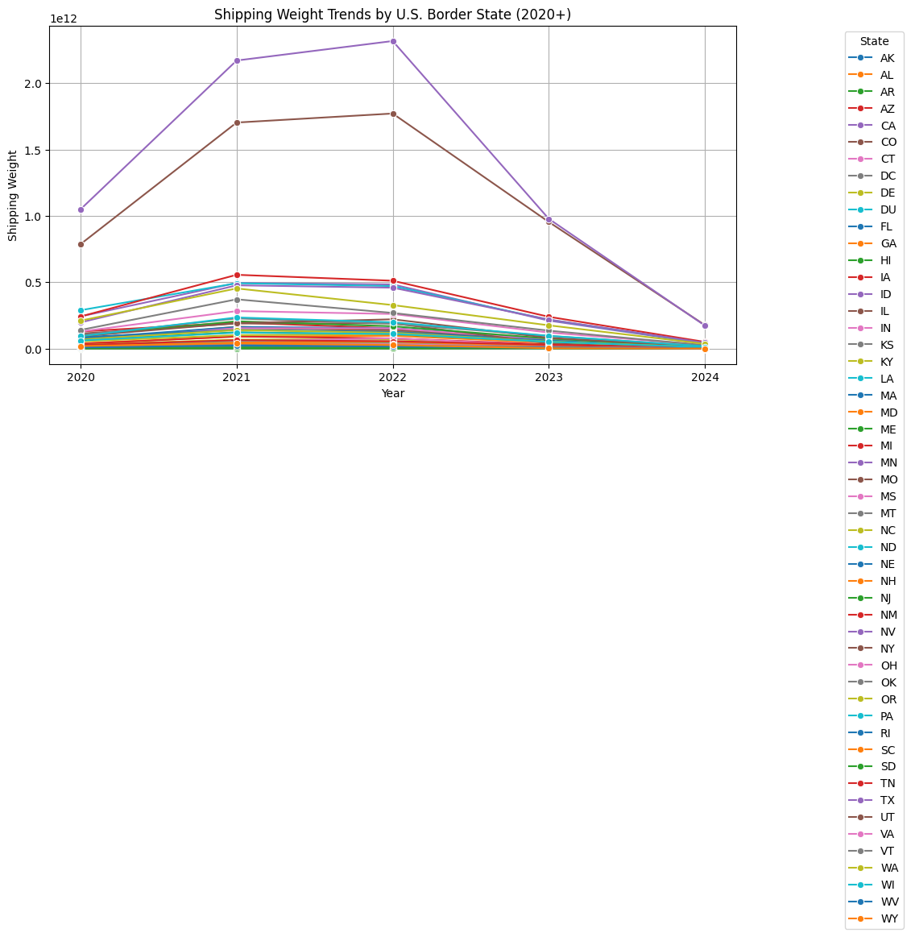
Are there notable trends in freight movement across different U.S. border states over time?
The analysis reveals that Texas is the leading U.S. border state in terms of shipping weight for transborder trade, handling approximately 6.69 trillion kg of goods. This highlights Texas as a critical logistics hub, especially for bulk freight entering from Mexico through key land ports like Laredo and El Paso.
Illinois follows with 5.39 trillion kg, leveraging Chicago’s rail infrastructure to move heavy commodities like grain, coal, and machinery across borders with Canada and Mexico.
Michigan (1.60T kg): Driven by automotive manufacturing and cross-border flow through the Detroit–Windsor corridor.
Louisiana (1.51T kg): Major shipping activity via Gulf Coast ports, focused on bulk liquids and petrochemicals.
California (1.47T kg): Despite handling large volumes, goods tend to be lighter, such as electronics and consumer tech through LA/Long Beach.
States like Oklahoma, Minnesota, Ohio, and Pennsylvania appear in the top 10, underscoring the strength of rail and inland port systems.

Slide 13
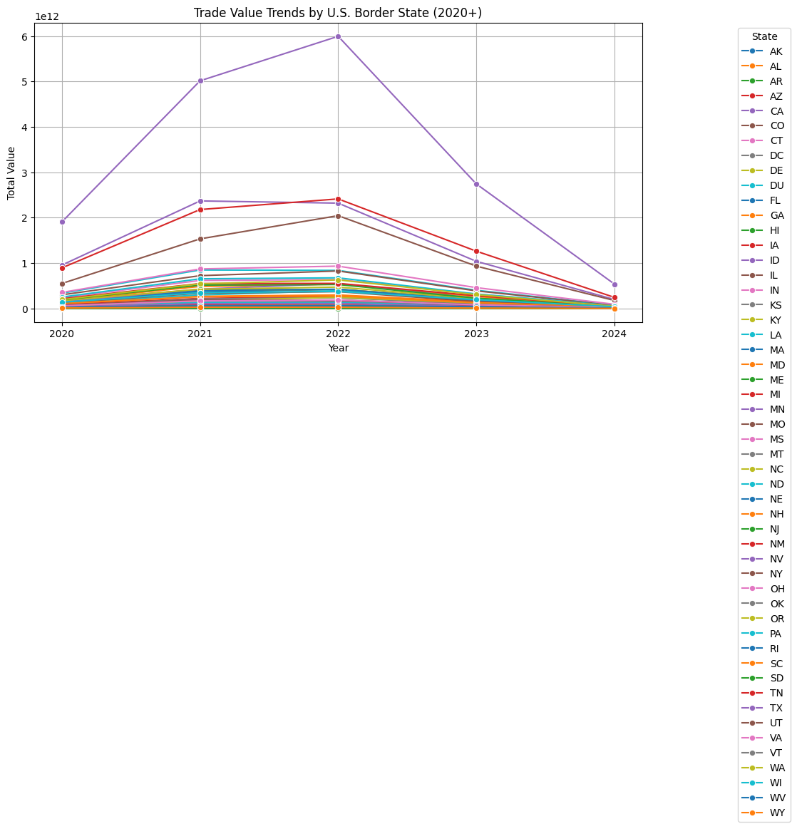
Are there notable trends in freight movement across different U.S. border states over time?
The analysis reveals that Texas (TX) overwhelmingly dominates in transborder trade value, accounting for approximately $16.19 trillion ; more than double that of any other state. This reflects Texas’s strategic role as the top land gateway for U.S.–Mexico trade.
Michigan (MI) and California (CA) follow closely with $6.99T and $6.88T respectively:
Illinois (IL) – $5.24T: Reflects the power of Chicago’s intermodal rail infrastructure, serving as a central node for cross-border goods.
Ohio (OH) – $2.71T: Driven by manufacturing exports, including machinery and chemicals.

Slide 14
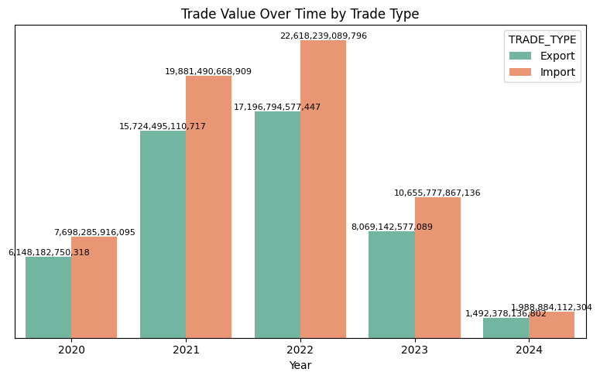
Most common trade types (import/export), and how their values and weights compare over time.
The analysis reveals that trade value experienced a dramatic surge between 2020 and 2022, with:
Exports peaking at $17.20 trillion in 2022.
Imports peaking even higher at $22.62 trillion the same year.
From 2023 to 2024, both exports and imports declined sharply, dropping to:
$1.49T (exports) and $1.99T (imports) in 2024 suggesting a possible economic slowdown, trade restrictions, or global disruptions.
Exports consistently remained lower than imports in most years, indicating a trade deficit, except in 2020, where exports slightly led.
2021 saw the highest growth in trade value, with exports increasing from $6.15T to $15.72T, and imports from $7.70T to $19.88T.
The downturn in 2023 and 2024 may signal economic concerns such as inflation, geopolitical instability, or shifting global supply chains.

Slide 15
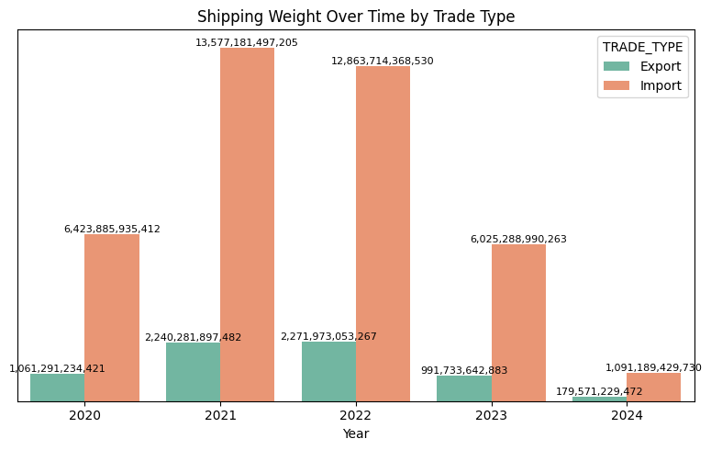
Most common trade types (import/export), and how their values and weights compare over time.
The analysis reveals that shipping weight for imports consistently surpassed exports between 2020 and 2024, highlighting the U.S.'s reliance on inbound bulk commodities and goods.
Imports peaked in 2021 at approximately 13.58 trillion kg, reflecting a post-pandemic surge in demand and supply chain restoration.
Exports peaked in 2022 at around 2.27 trillion kg, indicating a rebound in U.S. outbound trade activity.
From 2023 to 2024, both exports and imports experienced sharp declines:
Exports dropped to 0.18 trillion kg
Imports fell to 1.09 trillion kg

Slide 16

Actionable Solutions
Upgrade border infrastructure (especially in Texas, Illinois) to ease congestion.
Streamline domestic freight with automation and smarter route planning.
Invest in rail and vessel logistics for high-volume, long-distance shipments.
Use air and mail selectively for urgent or low-weight cargo.
Expand inland freight hubs (e.g., Oklahoma, Ohio) to support rising volumes.
Align logistics and marketing around seasonal demand cycles.
Leverage economies of scale for bulk foreign shipments.

Slide 17
Recommendations
Prioritize truck efficiency as the dominant transport mode.
Rebalance foreign trade toward higher-margin, lighter goods.
Monitor freight cost disparities—especially domestic vs. foreign.
Strengthen U.S.–Mexico and U.S.–Canada trade corridors.
Prepare infrastructure for future volume surges in shipping weight.
Focus on export diversification to sustain trade surpluses.
Adopt flexible logistics models to mitigate seasonal and geopolitical risks.

Slide 18
Thank You

